Slide 1

CREDIT CARD FRAUD DETECTION SOLUTIONS
Yathish N V
Paras S Khurana
Sameer Kulkarni
Sarthak Shivaraj

Slide 2
Credit Card Fraud Detection with Machine Learning
It is a process of data investigation by a Data Science team and the development of a model that will provide the best results in revealing and preventing fraudulent transactions. This is achieved through bringing together all meaningful features of card users’ transactions, such as Date, User Zone, Product Category, Amount, Provider, Client’s Behavioural Patterns, etc. The information is then run through a subtly trained model that finds patterns and rules so that it can classify whether a transaction is fraudulent or is legitimate. Now you know what is fraud protection, let’s look at the most common types of threats.

Slide 3
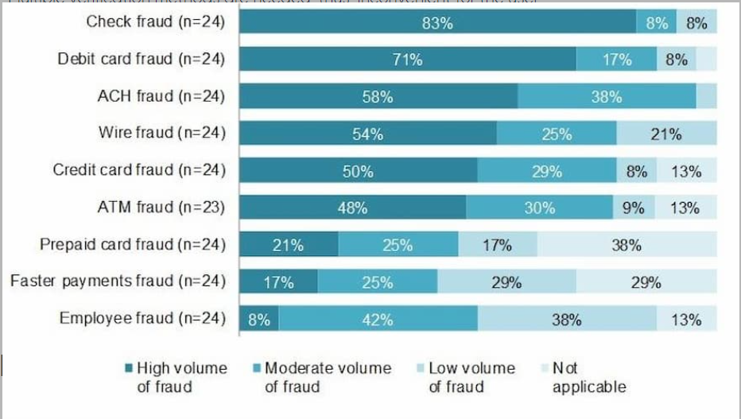

Slide 4
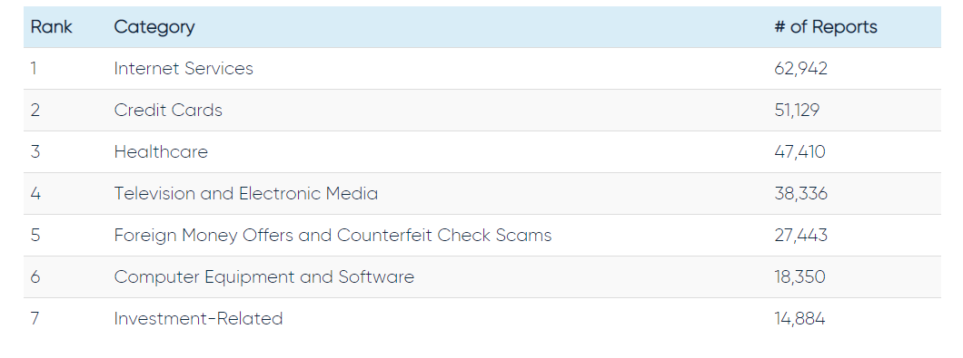
Types of Credit card Fraud

Slide 5
Credit Card Fraud Detection Systems
Building a strong AI Powered Smart Fraud Detection System has predictive ML model that learn from prior data and estimate the probability of a fraudulent credit card transaction.
Our approach to Build the system using ML
Collecting the dataset that can be used for modelling. Dataset link : https://www.kaggle.com/mlg-ulb/creditcardfraud
Data Cleaning and Outliers Removal
Feature Engineering
Unsupervised Learning Model
Supervised Learning Model
Metrics Calculation
Conclusion

Slide 6
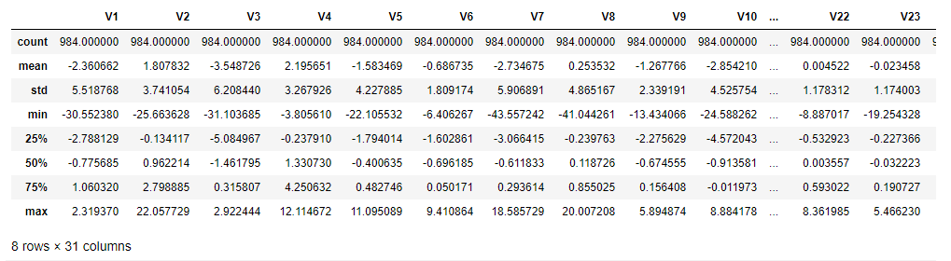
Sample Dataset

Slide 7
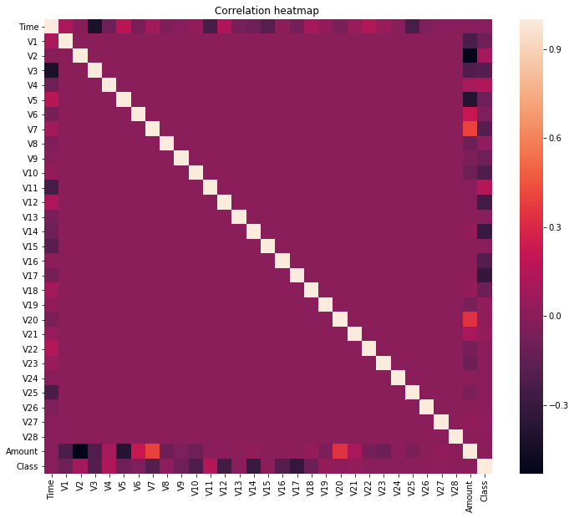
Correlation HeatMAp
For sensitive Data.

Slide 8
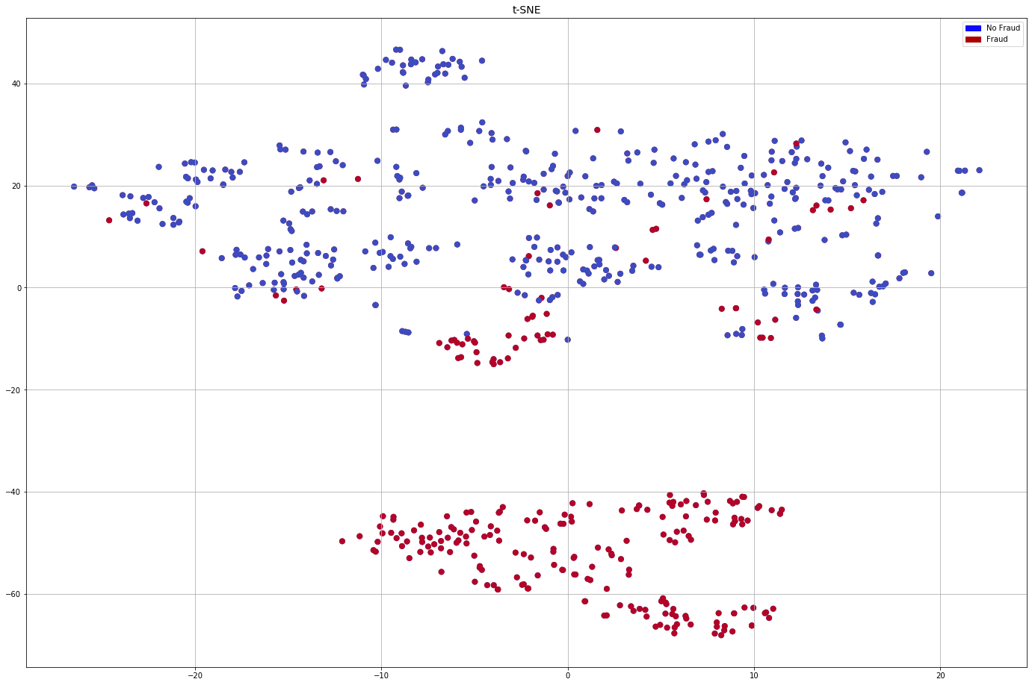
Dimensionality Reduction With t-SNE for Visualization
Normalization was done after Visualization
PCA was used for further scaling the data.

Slide 9
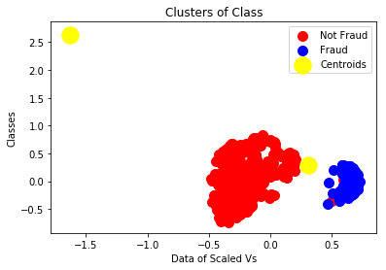
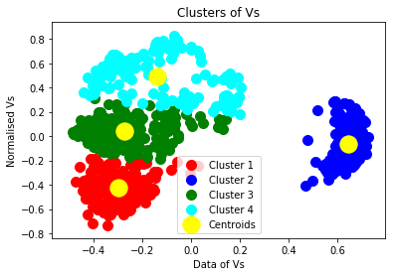
UNSUPERVISED LEARNING TECHNIQUES
K-Means Clustering
K-Means Clustering
DBSCAN
Agglomerative Clustering

Slide 10
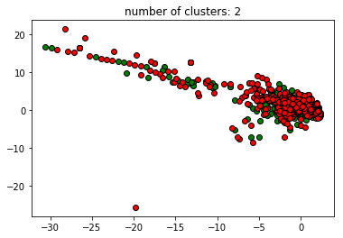
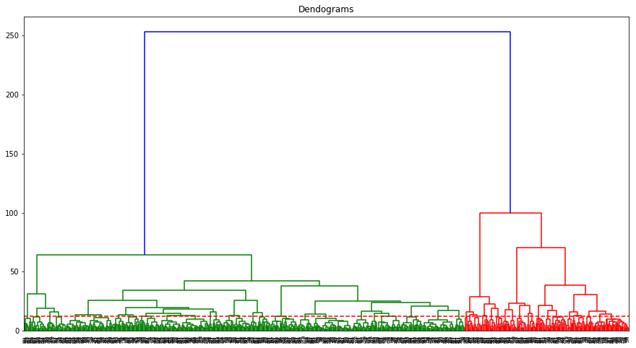
Agglomerative Clustering
Using Dendograms for Classification
RED-Fraud
GREEN- Normal
DBSCAN
-Not a good measure for Fraud detection.

Slide 11
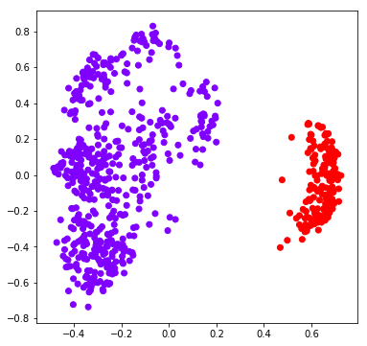
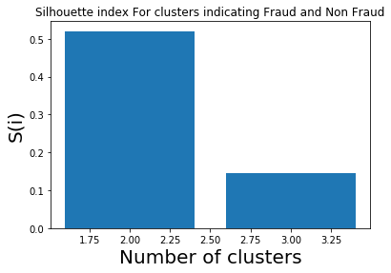
Agglomerative Clustering
Final Classification Between Fraud and Non Fraud
Using Silhouette Index for Calculation
Metric calculation for Testing Model Accuracy
Accuracy :
90.313%

Slide 12
SUPERVISED LEARNING TECHNIQUES
XGB Classifier
XGBoost is a decision-tree-based ensemble Machine Learning algorithm that uses a gradient boosting framework. In prediction problems involving unstructured data (images, text, etc.) ... A wide range of applications: Can be used to solve regression, classification, ranking, and user-defined prediction problems.
Random Forest Classifier
Accuracy :95.8333%
Metric calculation for Testing Model Accuracy
Accuracy : 96.54471%
Better Measurement than unsupervised since accuracy is higher.

Slide 13
Naive Bayes
Naive Bayes classifiers are a collection of classification algorithms based on Bayes' Theorem. It is not a single algorithm but a family of algorithms where all of them share a common principle, i.e. every pair of features being classified is independent of each other
Metric calculation for Testing Model Accuracy
Accuracy : 99.36623%
Highest Predicted Accuracy that Model Predicts using Naïve Bayes Algorithm.
HENCE NAÏVE BAYES ALGORITHM IS BEST SITUATED FOR FRAUD DETECTION USING SENSITIVE DATA WITH Clustering classification.

Slide 14
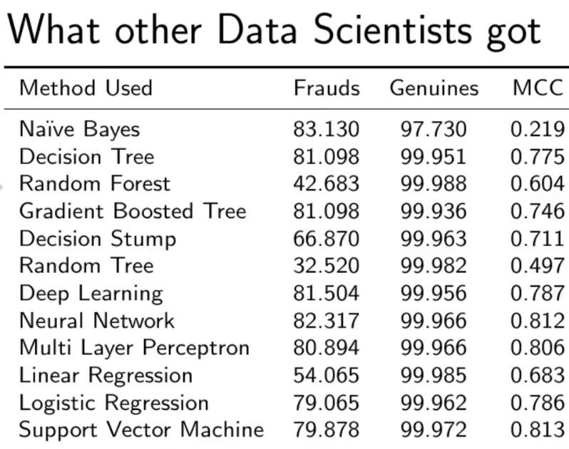
Our model Prediction
Naïve Bayes:99.366%
XG Boost Classifier: 96.5447
Agglomerative Clustering: 90.313%
Random Forest Classifier:95.833%

Slide 15
CONCLUSION
Fraud detection is a complex issue that requires a substantial amount of planning before throwing machine learning algorithms at it. Nonetheless, it is also an application of data science and machine learning for the good, which makes sure that the customer’s money is safe and not easily tampered with.
To effectively prevent the criminal actions that lead to the leakage of bank account information, skimming, counterfeit credit cards, the theft of billions of dollars annually, and the loss of reputation and customer loyalty, credit card issuers should consider the implementation of advanced Credit Card Fraud Prevention system and leveraging the most effective detection methods. Machine Learning-based methods can continuously improve the accuracy of fraud prevention solutions according to information about each cardholder’s behaviour. These AI solutions are suited perfectly not only for credit cards but can be implemented for eCommerce fraud detection purposes, as well as many other industries were financial transactions are involved.

Slide 16
THANK YOU

